Slide 1
Centralised Funding
and the
Division of Cognitive Labour
Shahar Avin
Centre for the Study of Existential Risk
University of Cambridge

Slide 2
The main aim of public science funding bodies is the increase of well-being via the scientific generation of new, reliable, communicable information.
Notes:
Back to the “Baker” perspective, trying to nail down the “madness” and get clear on what merit is.
Start from the basics - what are we trying to get
Setting aside development of tacit techniques and skilled individuals, as well as less straight forward effects like authority waterfalls

Slide 3
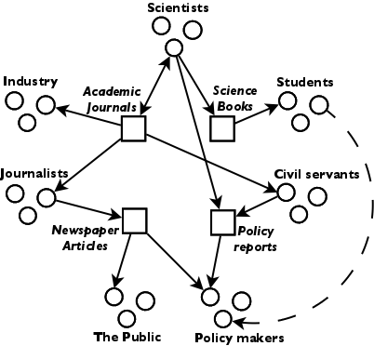
Notes:
Then ask: what are the real world causal pathways to get from the intervention to the aim?
Messy world from research to innovation and well-being
Importance of public repositories (Kitcher 2011)
Want to get the right information in the right time in the right repositories

Slide 4
The “epistemic fitness” of a corpus of information is the measure of fit between the causal consequences of the information existing in that corpus and the societally adopted notion of well-being.
f = F(I,W)
Notes:
Formalise to a concept of “epistemic fitness”
* Yes, it raises more questions than it solves, but it’s a place to start, and we can help ourselves to rich theory (evolutionary and otherwise)

Slide 5
How epistemic fitness can change over time
Duplication and redundancy
Convergence: novelty versus support
New avenues
Inertia
Revealed risk
Reduction and emergence
Practices and technology
Environmental effects
Communication technology
Hype
Isolation and boundaries
Notes:
Looked at some history (nothing new) and drew up a list, let’s go over it quickly (and of course there is more to be done here)

Slide 6
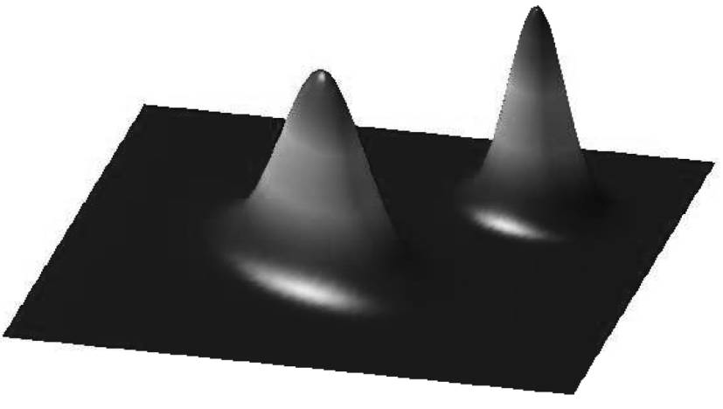
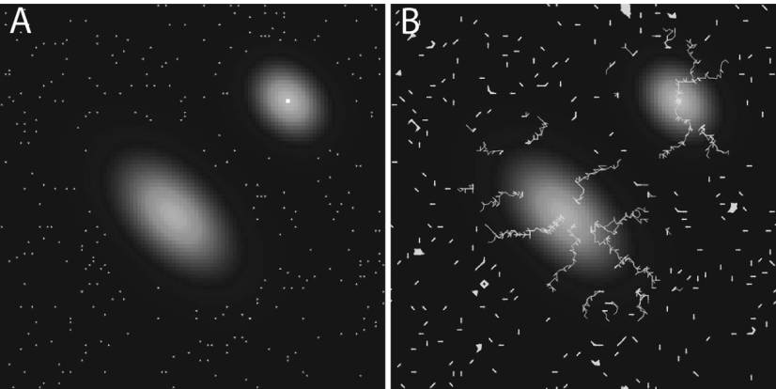
Michael Weisberg and Ryan Muldoon.
Epistemic Landscapes and the Division of Cognitive Labor.
Philosophy of Science, Vol. 76, No. 2 (April 2009)
Pöyhönen, Samuli. Value of cognitive diversity in science. Synthese (forthcoming)
Notes:
Start from an existing model
Static epistemic landscape
Agents persist on the landscape, varying individual exploration algorithms (hill climbers, followers and mavericks)

Slide 7
Adding selection mechanisms
Old boys
Best (God’s eye)
Best visible (peer review)
Lottery
Notes:
Add selection mechanisms - this is pretty much only for funding questions

Slide 8
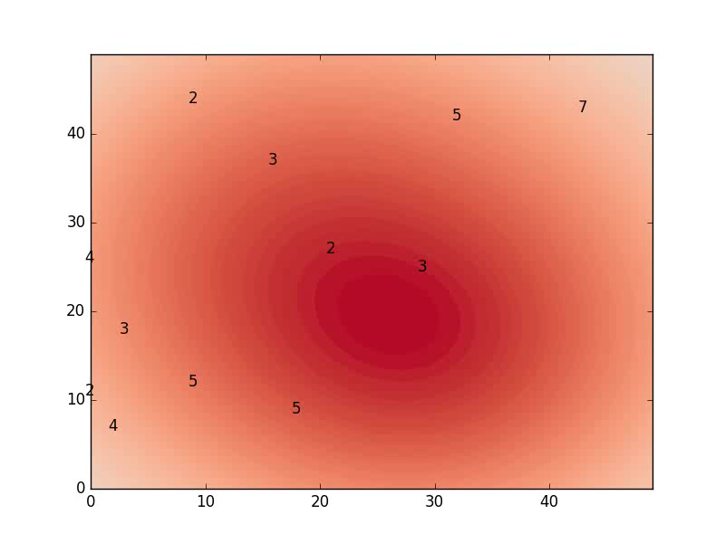
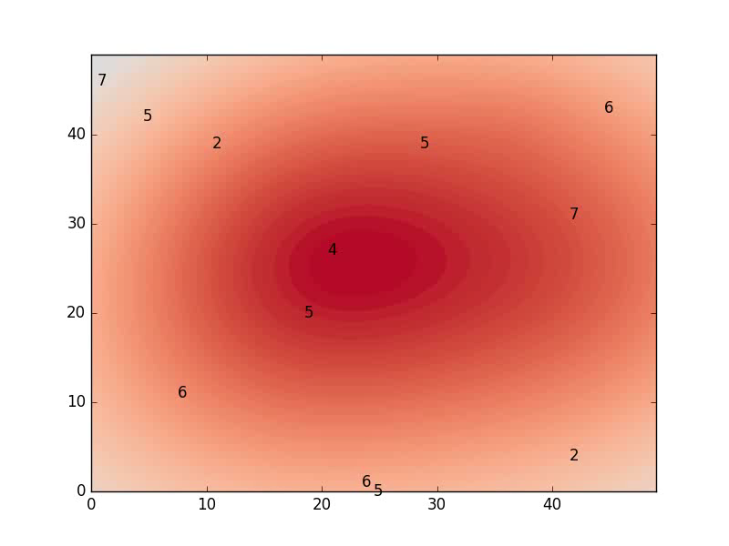
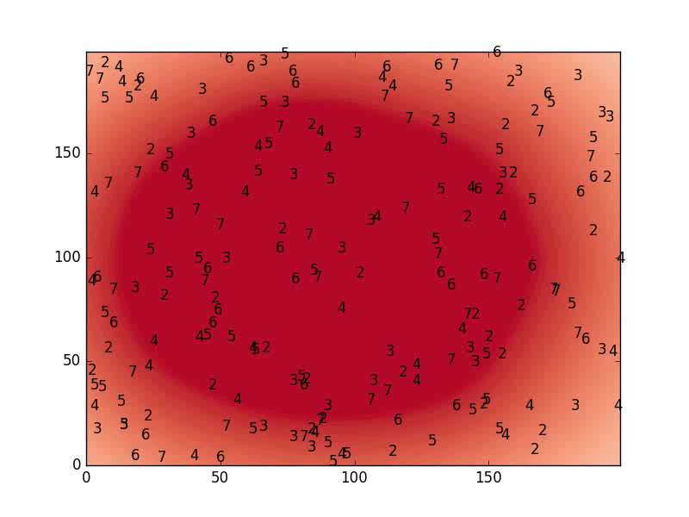
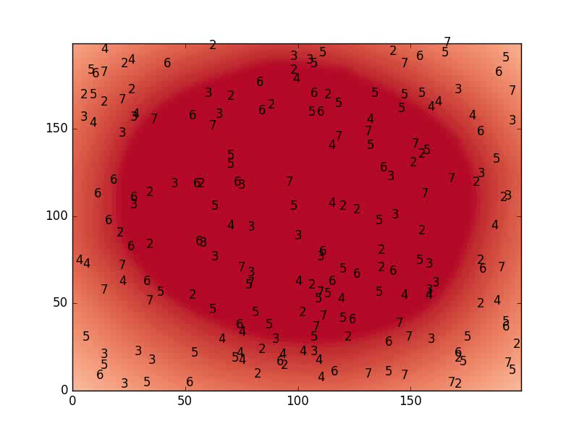

Slide 9
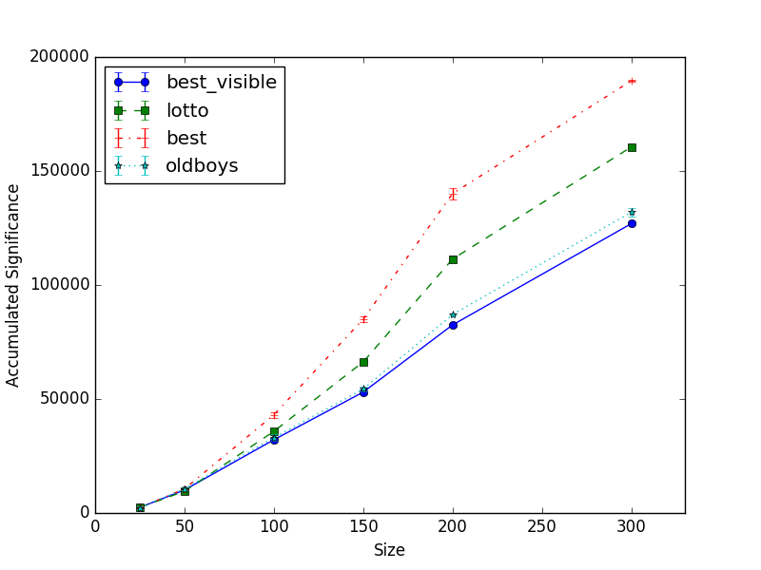

Slide 10
Adding more trigger events
No longer surprising
New avenues
Notes:
Add dynamic factors - can be used for more than just funding questions

Slide 11
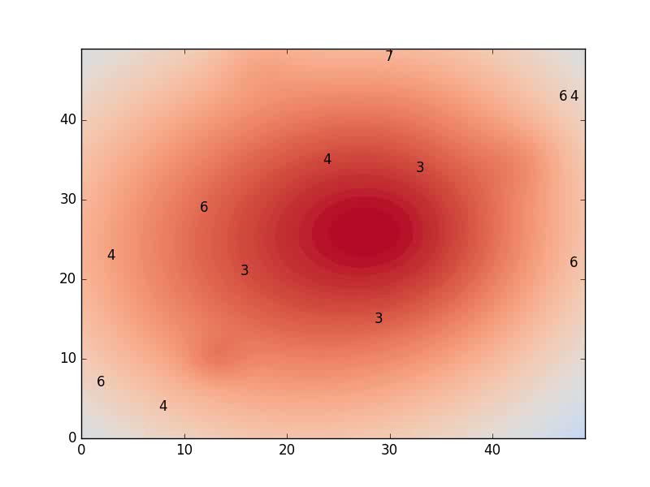
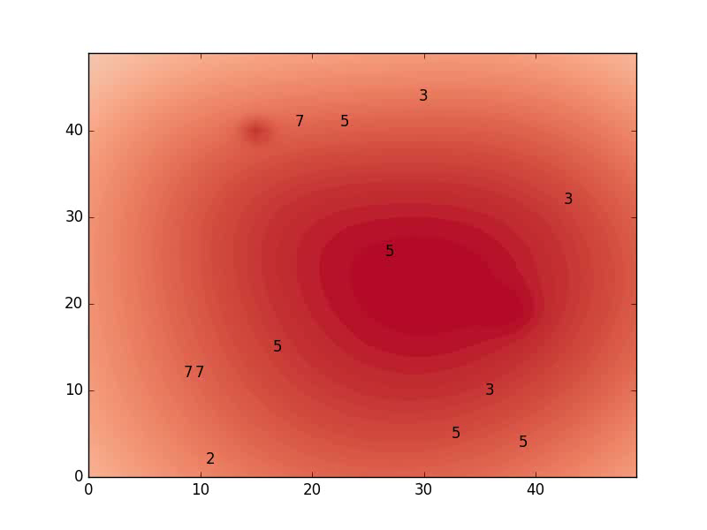
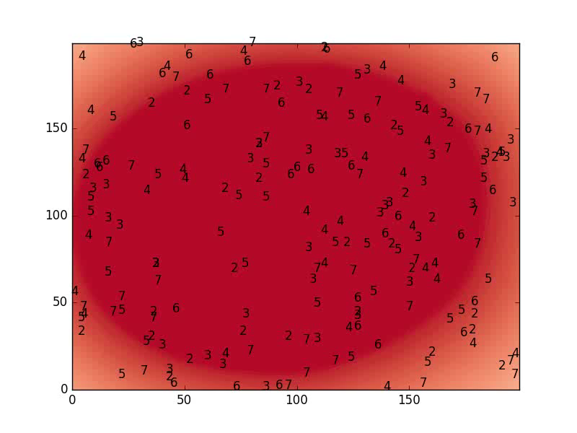
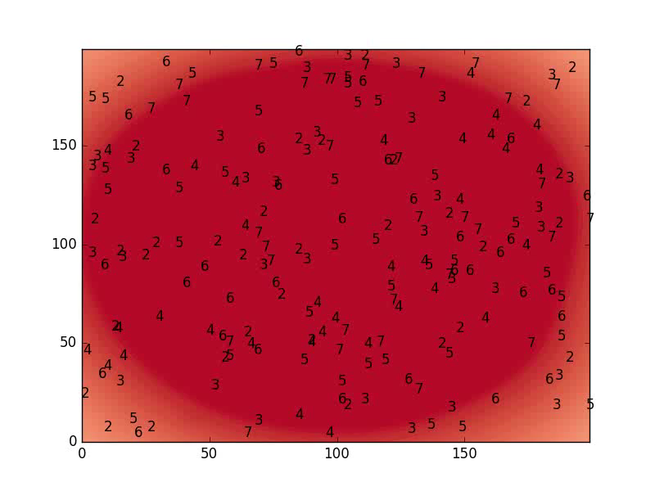

Slide 12
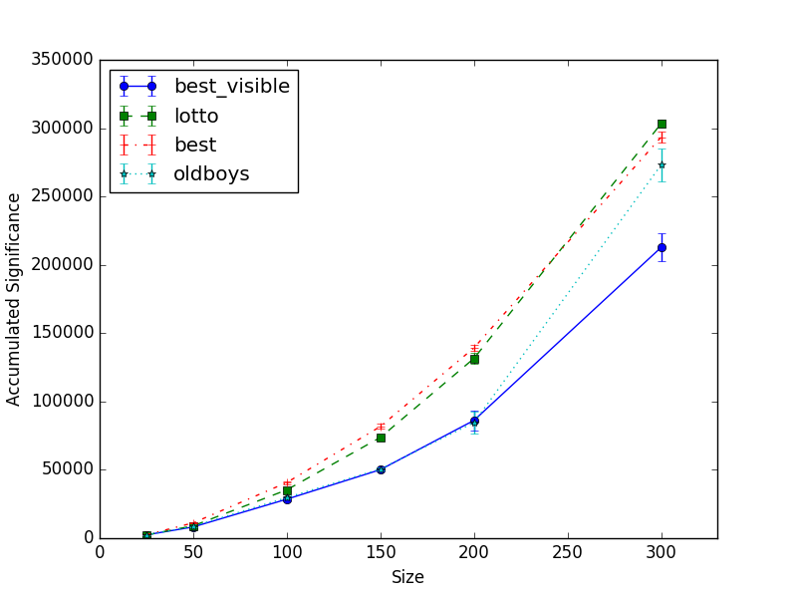

Slide 13
This project is for sale
Code!
Emotive topic
Policy relevance
Interesting
sa478@cam.ac.uk https://github.com/shaharavin/FundingSimulator.git

